Slide 1
Finding best location for nightclubs

Slide 2
Find the area for open nightclub is valuable
An incorrectly selected area for opening a nightclub will lead to a quick closure;
Experience of other open nightclubs give good start to new club;
Without good area no good club.

Slide 3
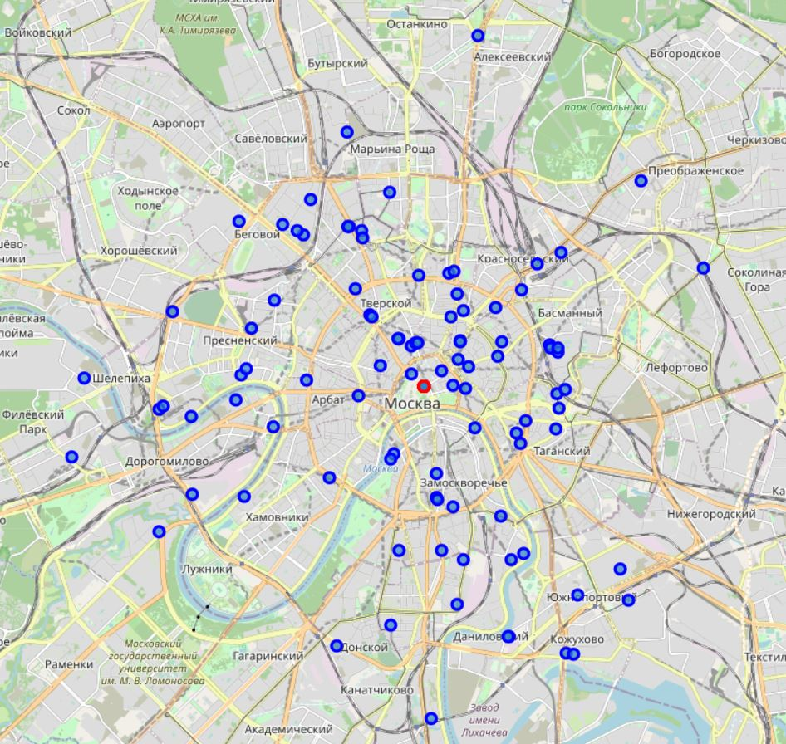
All night clubs in Moscow.

Slide 4
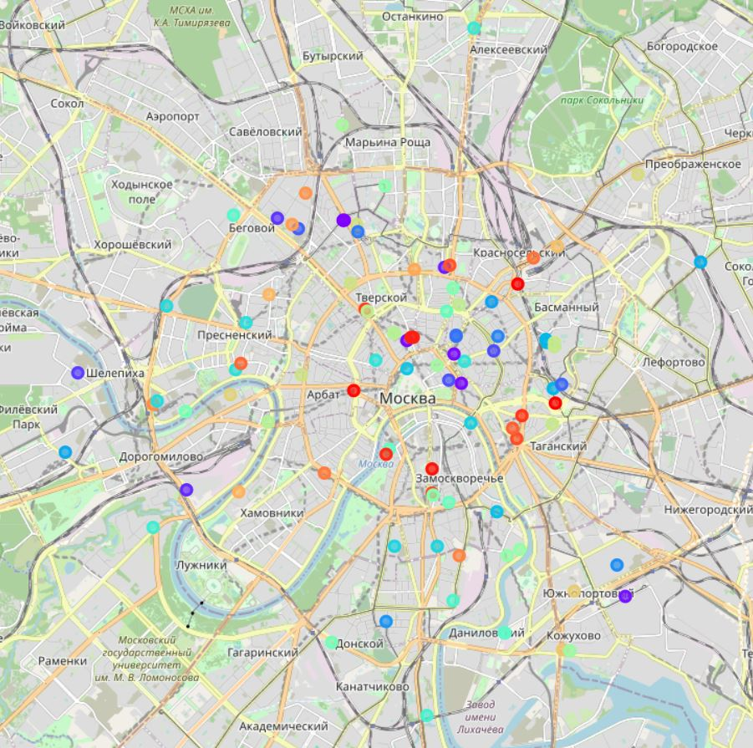
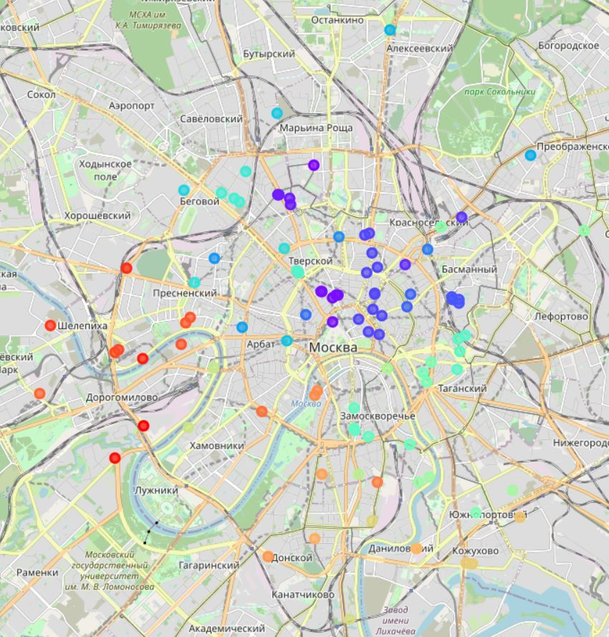
Division into clusters
DBSCAN gave a more meaningful result
Kmeans clustering didn’t give any result

Slide 5
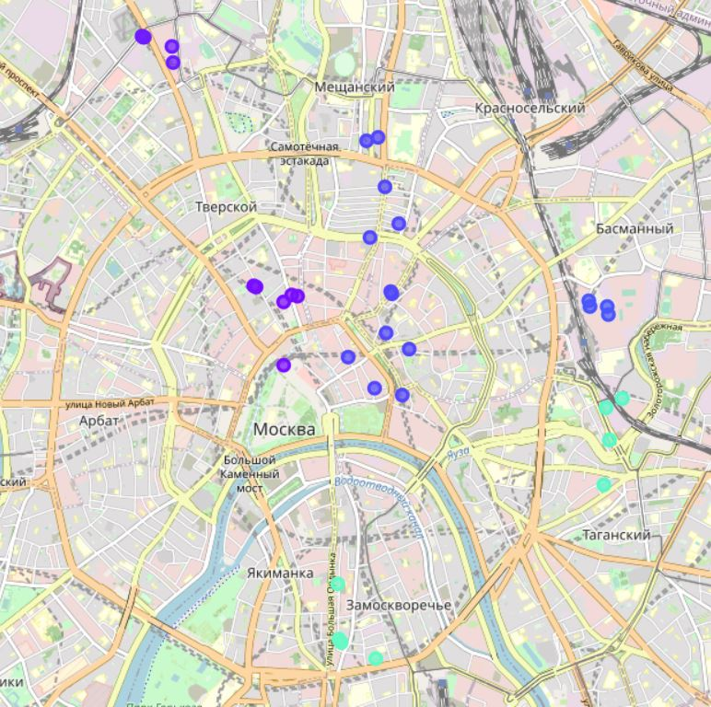
groups nightclubs
Distinction group of clubs more 4
All group near business area and tourist zones

Slide 6
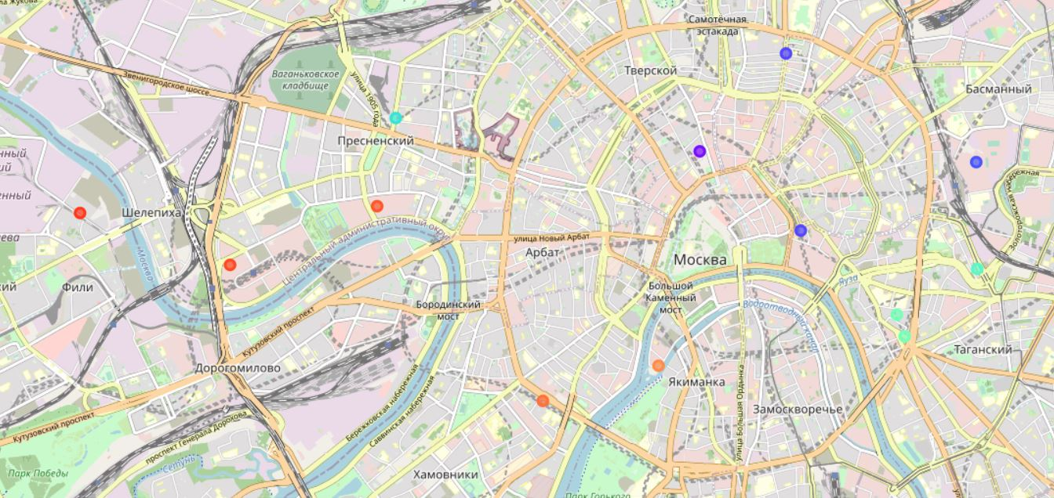
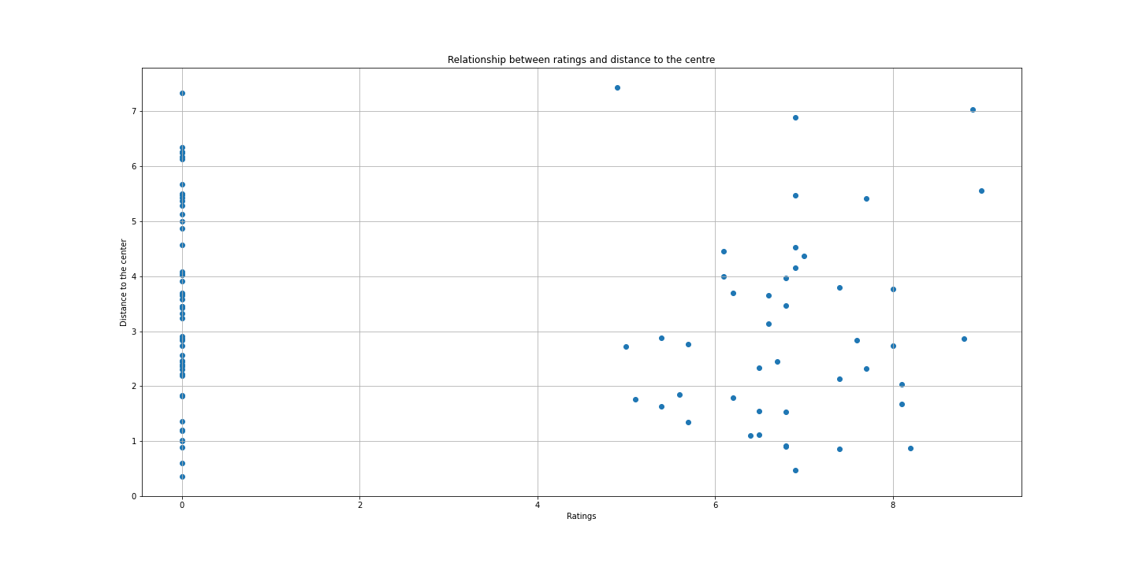
Clubs with a rating of 7.0 and higher
Testing of the hypothesis about the relationship between the distance to the center and the rating of night clubs was not confirmed
You can clearly see that there is no correlation on the map or on the scatter diagram.

Slide 7
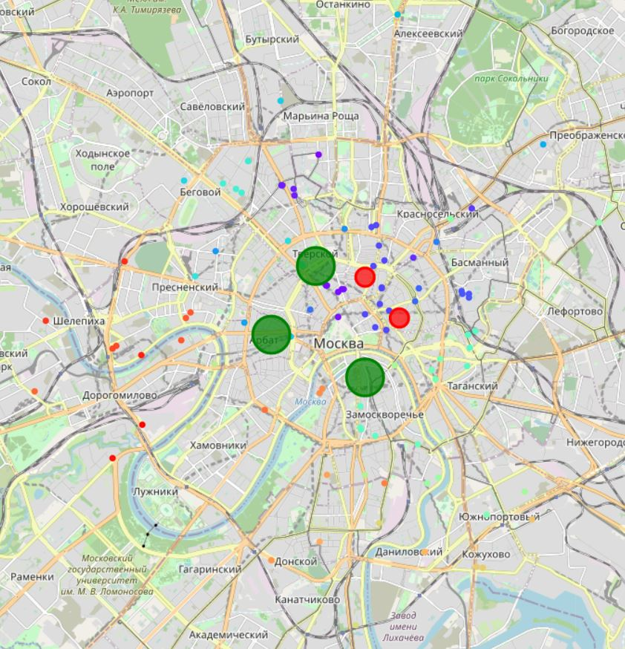
Best and worst areas
Green – good area for open nightclubs
Red – bed area for open nightclubs

Slide 8
Result and conclusion
A very large spread of night clubs around the city, gives the opportunity to a larger selection with minimal competition.
A very large number of new nightclubs makes it possible to promote in this area, using professional service and customer orientation, this is confirmed by a very small percentage of clubs with a high rating.
The study clearly shows a trend in the location of clubs close to tourist areas and theaters/museums, as well as business parks are very popular.

